Slide 1
Principles of Database Systems (CS307) Lecture 6: Database Design Using the E-R Model
Ran Cheng
Department of Computer Science and Engineering
Southern University of Science and Technology
Most contents are from slides made by Stéphane Faroult, Dr Yuxin Ma and the authors of Database System Concepts (7th Edition).
Their original slides have been modified to adapt to the schedule of CS307 at SUSTech.
Notes:
In this chapter, I will introduce how to retrieve data from one table. Just from one table. I will introduce how to retrieve data from multiple table in next chapter.

Slide 2
Application Development

Slide 3
Application Programs and User Interfaces
Most database users do not use a query language like SQL
An application program acts as the intermediary between users and the database
Applications split into
front-end
middle layer
backend
Front-end: user interface
Forms
Graphical user interfaces
Many interfaces are Web-based

Slide 4
Application Architecture Evolution
Three distinct era’s of application architecture
Mainframe (1960’s and 70’s)
Personal computer era (1980’s)
Web era (mid 1990’s onwards)
Web and Smartphone era (2010 onwards)

Slide 5
Web Interface
Web browsers have become the de-facto standard user interface to databases
Enable large numbers of users to access databases from anywhere
Avoid the need for downloading/installing specialized code, while providing a good graphical user interface
Javascript, Flash and other scripting languages run in browser, but are downloaded transparently
Examples: banks, airline and rental car reservations, university course registration and grading, and so on.

Slide 6
The World Wide Web
The Web is a distributed information system based on hypertext.
Most Web documents are hypertext documents formatted via the HyperText Markup Language (HTML)
HTML documents contain
text along with font specifications, and other formatting instructions
hypertext links to other documents, which can be associated with regions of the text.
forms, enabling users to enter data which can then be sent back to the Web server

Slide 7
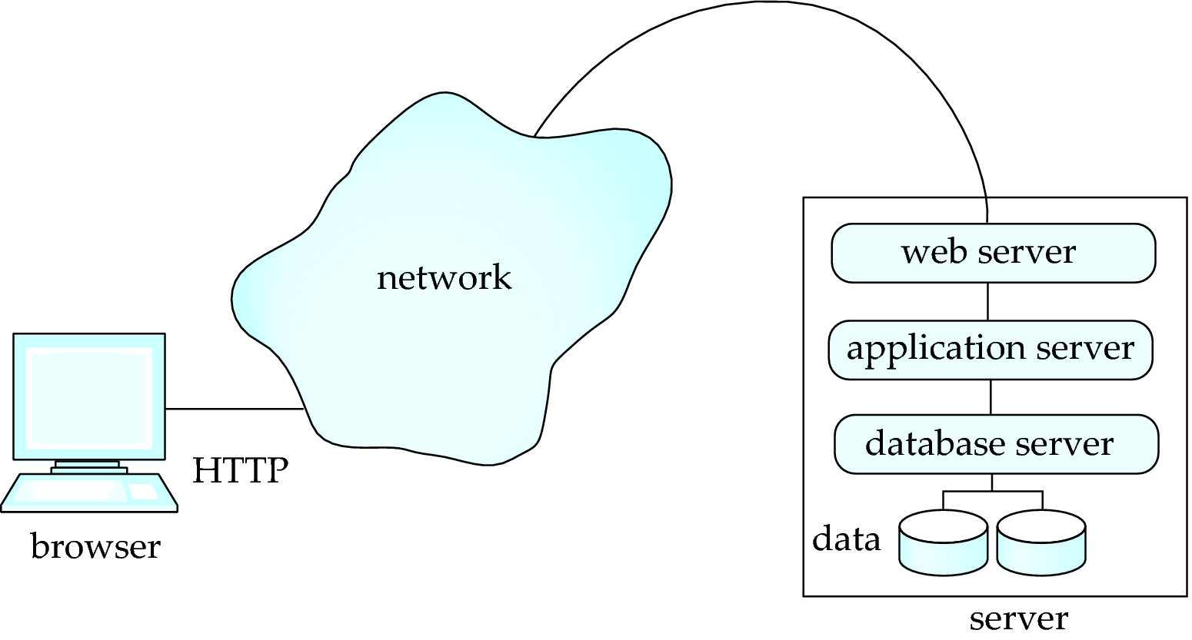
Three-Layer Web Architecture

Slide 8
HTML and HTTP
HTML provides formatting, hypertext link, and image display features
including tables, stylesheets (to alter default formatting), etc.
HTML also provides input features
Select from a set of options
Pop-up menus, radio buttons, check lists
Enter values
Text boxes
Filled in input sent back to the server, to be acted upon by an executable at the server
HyperText Transfer Protocol (HTTP) used for communication with the Web server

Slide 9
JavaScript
Javascript very widely used
Forms basis of new generation of Web applications (called Web 2.0 applications) offering rich user interfaces
Javascript functions can
Check input for validity
Modify the displayed Web page, by altering the underling document object model (DOM) tree representation of the displayed HTML text
Communicate with a Web server to fetch data and modify the current page using fetched data, without needing to reload/refresh the page
Forms basis of AJAX technology used widely in Web 2.0 applications
E.g. on selecting a country in a drop-down menu, the list of states in that country is automatically populated in a linked drop-down menu

Slide 10
How to design a database then?

Slide 11
The New Running Example

Slide 12
Design Phases
Initial phase: characterize fully the data needs of the prospective database users.
Second phase: choosing a data model
Applying the concepts of the chosen data model
Translating these requirements into a conceptual schema of the database
A fully developed conceptual schema indicates the functional requirements of the enterprise
Describe the kinds of operations (or transactions) that will be performed on the data

Slide 13
Design Phases
Final Phase: Moving from an abstract data model to the implementation of the database
Logical Design – Deciding on the database schema.
Database design requires that we find a “good” collection of relation schemas.
Business decision – What attributes should we record in the database?
Computer Science decision – What relation schemas should we have and how should the attributes be distributed among the various relation schemas?
Physical Design – Deciding on the physical layout of the database

Slide 14
Design Alternatives
In designing a database schema, we must ensure that we avoid two major pitfalls (陷阱):
Redundancy: a bad design may result in repeated information
Redundant representation of information may lead to data inconsistency among the various copies of information
Incompleteness: a bad design may make certain aspects of the enterprise difficult or impossible to model
Avoiding bad designs is not enough
There may be a large number of good designs from which we must choose

Slide 15
Entity-Relationship Model (E-R Model) Entity-Relationship Diagram (E-R Diagram)

Slide 16
Design Approaches
Entity Relationship Model (covered in this chapter)
Models an enterprise as a collection of entities and relationships
Entity: a “thing” or “object” in the enterprise that is distinguishable from other objects
Described by a set of attributes
Relationship: an association among several entities
Represented diagrammatically by an entity-relationship diagram (E-R diagram)
Normalization Theory (coming in the next few weeks)
Formalize what designs are bad, and test for them

Slide 17
Entity Sets
An entity is an object that exists and is distinguishable from other objects
Example: specific person, company, event, plant
An entity set is a set of entities of the same type that share the same properties
Example: set of all persons, companies, trees, holidays
An entity is represented by a set of attributes, i.e., descriptive properties possessed by all members of an entity set.
Example:
instructor = (ID, name, salary) course = (course_id, title, credits)
A subset of the attributes form a primary key of the entity set, i.e., uniquely identifying each member of the set.

Slide 18
Representing Entity sets in ER Diagram
Entity sets can be represented graphically as follows:
Rectangles represent entity sets.
Attributes listed inside entity rectangle
Underline indicates primary key attributes

Slide 19
Relationship Sets
A relationship is an association among several entities 44553 (Peltier) advisor 22222 (Einstein) student entity relationship set instructor entity
A relationship set is a mathematical relation among n ≥ 2 entities, each taken from entity sets
where (e₁, e₂, …, e_{n}) is a relationship
Example: (44553,22222) ∈ advisor

Slide 20
Relationship Sets
Example: we define the relationship set advisor to denote the associations between students and the instructors who act as their advisors.
Pictorially, we draw a line between related entities

Slide 21
Representing Relationship Sets via E-R Diagrams
Diamonds represent relationship sets

Slide 22
Relationship Sets (Cont.)
An attribute can also be associated with a relationship set.
For instance, the advisor relationship set between entity sets instructor and student may have the attribute date which tracks when the student started being associated with the advisor

Slide 23
Relationship Sets with Attributes

Slide 24
Roles
Entity sets of a relationship need not be distinct
That is to say, we can create self-pointing relationships for an entity set
Each occurrence of an entity set plays a “role” in the relationship
Example: A relationship set to represent the prerequisites of a course
E.g., Data Structure depends on Introduction to Programming
The labels “course_id” and “prereq_id” are called roles

Slide 25
Degree of a Relationship Set
Binary relationship
Involve two entity sets (or degree two).
Most relationship sets in a database system are binary
Relationships between more than two entity sets are rare
Example: students work on research projects under the guidance of an instructor.
relationship proj_guide is a ternary relationship between instructor, student, and project

Slide 26
Non-binary Relationship Sets
Most relationship sets are binary
There are occasions when it is more convenient to represent relationships as non-binary
E-R Diagram with a Ternary Relationship

Slide 27
Complex Attributes
Attribute types:
Simple and composite attributes.
Single-valued and multivalued attributes
Example: multivalued attribute: phone_numbers
A person can have 1 or more phone numbers at the same time
Derived attributes
Can be computed from other attributes
Example: age, given date_of_birth
Domain: The set of permitted values for each attribute

Slide 28
Composite Attributes
Composite attributes allow us to divided attributes into subparts (other attributes)
Sometimes we may only use part of the attributes, where the composite attribute is a good design choice

Slide 29
Mapping Cardinality Constraints
Mapping Cardinality（映射基数）
Express the number of entities to which another entity can be associated via a relationship set.
Most useful in describing binary relationship sets
For a binary relationship set, the mapping cardinality must be one of the following types:
One to one
One to many
Many to one
Many to many

Slide 30
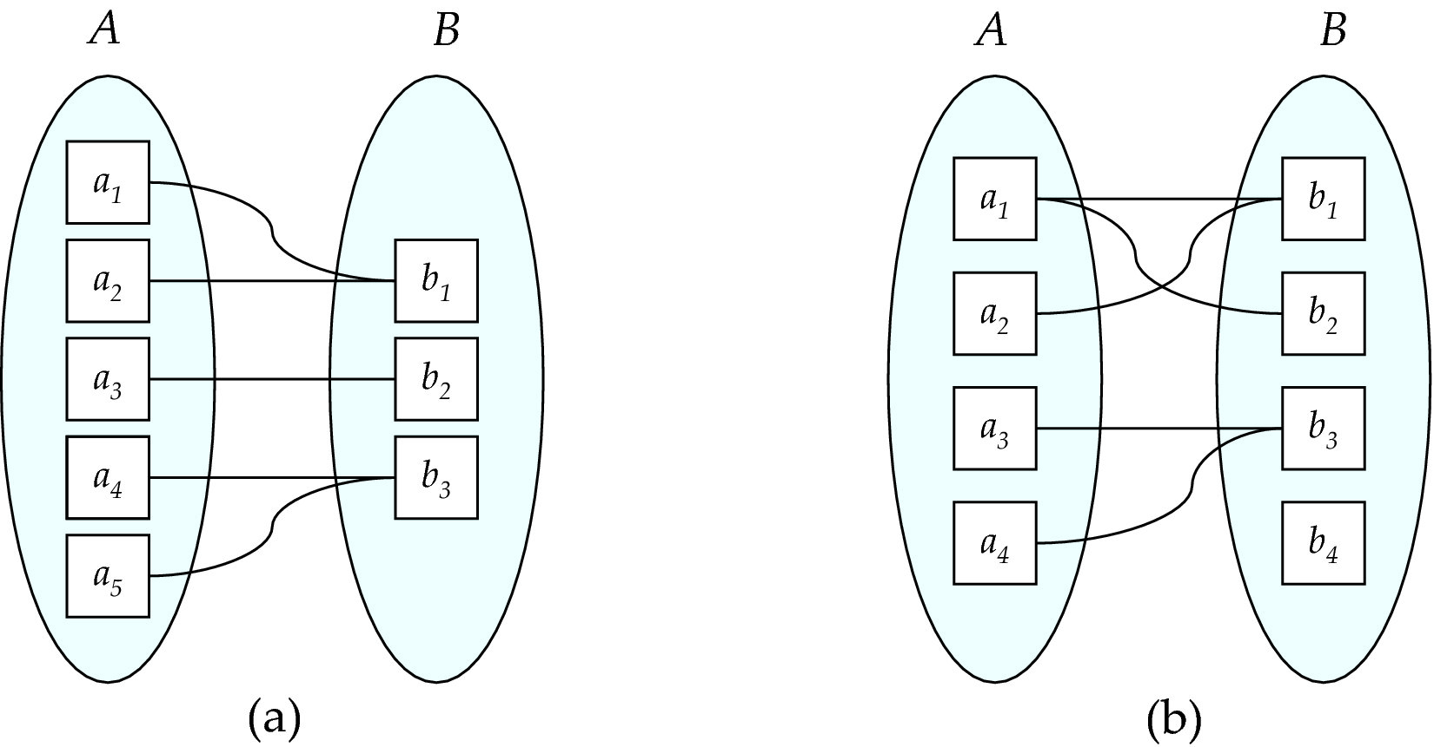
Mapping Cardinalities
Many to one
Many to many
Note: Some elements in A and B may not be mapped to any
elements in the other set
Notes:
映射基数

Slide 31
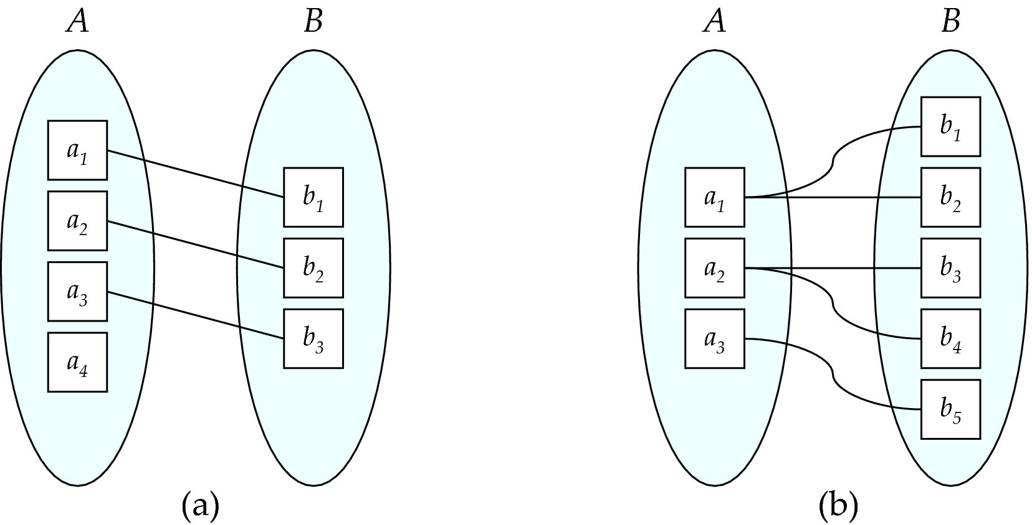
Mapping Cardinalities
One to one
One to many
Note: Some elements in A and B may not be mapped to any
elements in the other set
Notes:
映射基数

Slide 32
Representing Cardinality Constraints in ER Diagram
We express cardinality constraints by:
drawing either a directed line (→), signifying “one,”
or an undirected line (—), signifying “many,”
… between the relationship set and the entity set.
One-to-one relationship between an instructor and a student :
A student is associated with at most one instructor via the relationship advisor

Slide 33
Representing Cardinality Constraints in ER Diagram
One-to-many relationship between an instructor and a student
an instructor is associated with several (including 0) students via advisor
a student is associated with at most one instructor via advisor

Slide 34
Representing Cardinality Constraints in ER Diagram
In a many-to-one relationship between an instructor and a student,
an instructor is associated with at most one student via advisor
and a student is associated with several (including 0) instructors via advisor

Slide 35
Representing Cardinality Constraints in ER Diagram
Many-to-many relationship:
An instructor is associated with several (possibly 0) students via advisor
A student is associated with several (possibly 0) instructors via advisor

Slide 36
Total and Partial Participation
Total participation (indicated by double line)
Every entity in the entity set participates in at least one relationship in the relationship set
Example: Participation of student in advisor relation is total
i.e., every student must have an associated instructor
Partial participation
Some entities may not participate in any relationship in the relationship set
Example: participation of instructor in advisor is partial

Slide 37
Notation for Expressing More Complex Constraints
A line may have an associated minimum and maximum cardinality, shown in the form l..h, where l is the minimum and h the maximum cardinality
A minimum value of 1 indicates total participation.
A maximum value of 1 indicates that the entity participates in at most one relationship
A maximum value of * indicates no limit.
Example
Instructor can advise 0 or more students
A student must have 1 advisor; cannot have multiple advisors

Slide 38
Primary Key
Primary keys provide a way to specify how entities and relations are distinguished

Slide 39
Primary Key for Entity Sets
By definition, individual entities are distinct
From database perspective, the differences among them must be expressed in terms of their attributes.
The values of the attribute values of an entity must be such that they can uniquely identify the entity.
No two entities in an entity set are allowed to have exactly the same value for all attributes
A key for an entity is a set of attributes that suffice to distinguish entities from each other

Slide 40
Primary Key for Relationship Sets
To distinguish among the various relationships of a relationship set, we use the individual primary keys of the entities in the relationship set.
Let R be a relationship set involving entity sets E1, E2, .. En
The primary key for R consists of the union of the primary keys of entity sets E1, E2, ..En
If the relationship set R has attributes a₁, a₂, .., a_{m} associated with it, the primary key of R also includes the attributes a₁, a₂, .., a_{m}
Example: relationship set “advisor”.
The primary key consists of instructor.ID and student.ID
The choice of the primary key for a relationship set depends on the mapping cardinality of the relationship set.

Slide 41
Choice of Primary key for Binary Relationship
Many-to-Many relationships
The preceding union of the primary keys is a minimal superkey and is chosen as the primary key.
One-to-one relationships
The primary key of either one of the participating entity sets forms a minimal superkey, and either one can be chosen as the primary key.
* K is a superkey of R if values for K are sufficient to identify a unique tuple of each possible relation r(R)
Example: {ID} and {ID,name} are both superkeys of instructor.

Slide 42
Choice of Primary key for Binary Relationship
One-to-Many relationships
The primary key of the “Many” side is a minimal superkey and is used as the primary key.
Many-to-one relationships
The primary key of the “Many” side is a minimal superkey and is used as the primary key.

Slide 43
Weak Entity Sets
Consider a section entity, which is uniquely identified by a course_id, semester, year, and sec_id.
Clearly, section entities are related to course entities.
We need sec_course to indicate the relationship between a section and a course. However, the information in relationship sec_course is redundant.
One option to deal with this redundancy is to get rid of the relationship sec_course; however, by doing so the relationship between section and course becomes implicit in an attribute, which is not desirable.

Slide 44
Weak Entity Sets
An alternative way to deal with this redundancy is NOT to store the attribute course_id in the section entity and to only store the remaining attributes section_id, year, and semester.
However, the entity set section then does not have enough attributes to identify a particular section entity uniquely
To deal with this problem, we treat the relationship sec_course as a special relationship that provides extra information — the course_id — required to identify section entities uniquely.
A weak entity set is one whose existence is dependent on another entity, called its identifying entity
Instead of associating a primary key with a weak entity, we use the identifying entity, along with extra attributes called discriminator to uniquely identify a weak entity.

Slide 45
Weak Entity Sets
An entity set that is not a weak entity set is termed a strong entity set.
Every weak entity must be associated with an identifying entity; that is, the weak entity set is said to be existence dependent on the identifying entity set.
The identifying entity set is said to own the weak entity set that it identifies.
The relationship associating the weak entity set with the identifying entity set is called the identifying relationship
Note that the relational schema we eventually create from the entity set section does have the attribute course_id, for reasons that will become clear later, even though we have dropped the attribute course_id from the entity set section.

Slide 46
Expressing Weak Entity Sets
In E-R diagrams, a weak entity set is depicted via a double rectangle.
We underline the discriminator of a weak entity set with a dashed line.
The relationship set connecting the weak entity set to the identifying strong entity set is depicted by a double diamond.
Primary key for section – (course_id, sec_id, semester, year)

Slide 47
Redundant Attributes
Suppose we have entity sets:
student, with attributes: ID, name, tot_cred, dept_name
department, with attributes: dept_name, building, budget
We model the fact that each student has an associated department using a relationship set stud_dept
The attribute dept_name in student below replicates information present in the relationship and is therefore redundant
and needs to be removed.
BUT: when converting back to tables, in some cases the attribute gets reintroduced.

Slide 48
Representation of Entity Sets
A strong entity set reduces to a schema with the same attributes
student(ID, name, tot_cred)
A weak entity set becomes a table that includes a column for the primary key of the identifying strong entity set
section (course_id, sec_id, sem, year)
Example

Slide 49
Representation of Entity Sets with Composite Attributes
Composite attributes are flattened out by creating a separate attribute for each component attribute
Example: given entity set instructor with composite attribute name with component attributes first_name and last_name the schema corresponding to the entity set has two attributes name_first_name and name_last_name
Prefix omitted if there is no ambiguity (name_first_name could be first_name)
Ignoring multivalued attributes, extended instructor schema is
instructor(ID, first_name, middle_initial, last_name, street_number, street_name, apt_number, city, state, zip_code, date_of_birth)

Slide 50
Representation of Entity Sets with Multivalued Attributes
A multivalued attribute M of an entity E is represented by a separate schema EM
Schema EM has attributes corresponding to the primary key of E and an attribute corresponding to multivalued attribute M
Example: Multivalued attribute phone_number of instructor is represented by a schema:
inst_phone= ( ID, phone_number)
Each value of the multivalued attribute maps to a separate tuple of the relation on schema EM
For example, an instructor entity with primary key 22222 and phone numbers 456-7890 and 123-4567 maps to two tuples:
(22222, 456-7890) and (22222, 123-4567)

Slide 51
Representation of Relationship Sets
A many-to-many relationship set is represented as a schema with attributes for the primary keys of the two participating entity sets, and any descriptive attributes of the relationship set.
Example: schema for relationship set advisor
advisor = (s_id, i_id)

Slide 52
Redundancy of Schemas
Many-to-one and one-to-many relationship sets that are total on the many-side can be represented by adding an extra attribute to the “many” side, containing the primary key of the “one” side
Example: Instead of creating a schema for relationship set inst_dept, add an attribute dept_name to the schema arising from entity set instructor
Example

Slide 53
Redundancy of Schemas
For one-to-one relationship sets, either side can be chosen to act as the “many” side
That is, an extra attribute can be added to either of the tables corresponding to the two entity sets
* If participation is partial on the “many” side, replacing a schema by an extra attribute in the schema corresponding to the “many” side could result in null values

Slide 54
Redundancy of Schemas
The schema corresponding to a relationship set linking a weak entity set to its identifying strong entity set is redundant.
Example: The section schema already contains the attributes that would appear in the sec_course schema

Slide 55
Normalization

Slide 56

Normalization
Every non key attribute must provide a fact about the key,
the whole key,
and nothing but the key.
William Kent (1936 – 2005)
William Kent. "A Simple Guide to Five Normal Forms in Relational Database Theory", Communications of the ACM 26 (2), Feb. 1983, pp. 120–125.

Slide 57
Recall: Design Alternatives
In designing a database schema, we must ensure that we avoid two major pitfalls:
Redundancy: a bad design may result in repeat information
Redundant representation of information may lead to data inconsistency among the various copies of information
Incompleteness: a bad design may make certain aspects of the enterprise difficult or impossible to model
Avoiding bad designs is not enough
There may be a large number of good designs from which we must choose

Slide 58
Recall: Design Alternatives
In designing a database schema, we must ensure that we avoid two major pitfalls:
Redundancy: a bad design may result in repeat information
Redundant representation of information may lead to data inconsistency among the various copies of information
Incompleteness: a bad design may make certain aspects of the enterprise difficult or impossible to model
Avoiding bad designs is not enough
There may be a large number of good designs from which we must choose
Do we have any guidelines on how to get a good design?
Normal Forms!

Slide 59
First Normal Form (1NF)
A relational schema R is in first normal form if the domains of all attributes of R are atomic
Domain is atomic if its elements are considered to be indivisible units
Examples of non-atomic domains:
Set of names, composite attributes
Identification numbers like CS101 that can be broken up into parts
However, in practice, we can also consider it atomic
Non-atomic values complicate storage and encourage redundant (repeated) storage of data

Slide 60
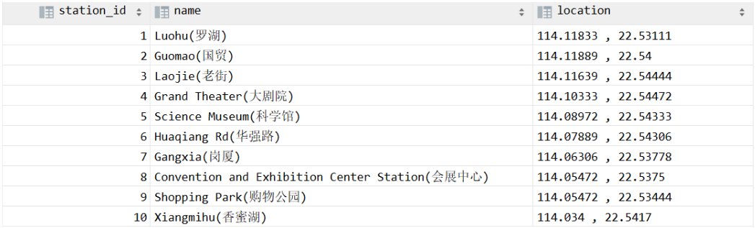
First Normal Form (1NF)
Example: Non-atomic attribute

Slide 61
First Normal Form (1NF)
Another example: Starring
Problems: 1) Redundant names; 2) difficulties in updating/deleting a specific person; 3) extra cost in splitting names; 4) difficulties in making statistics
Movie ID | Movie Title | Country | Year | Director | Starring
0 | Citizen Kane | US | 1941 | welles, o. | Orson Welles, Joseph Cotten
1 | La règle du jeu | FR | 1939 | Renoir, J. | Roland Toutain, Nora Grégor, Marcel Dalio, Jean Renoir
2 | North By Northwest | US | 1959 | HITCHCOCK, A. | Cary Grant, Eva Marie Saint, James Mason
3 | Singin' in the Rain | US | 1952 | Donen/Kelly | Gene Kelly, Debbie Reynolds, Donald O'Connor
4 | Rear Window | US | 1954 | Alfred Hitchcock | James Stewart, Grace Kelly

Slide 62
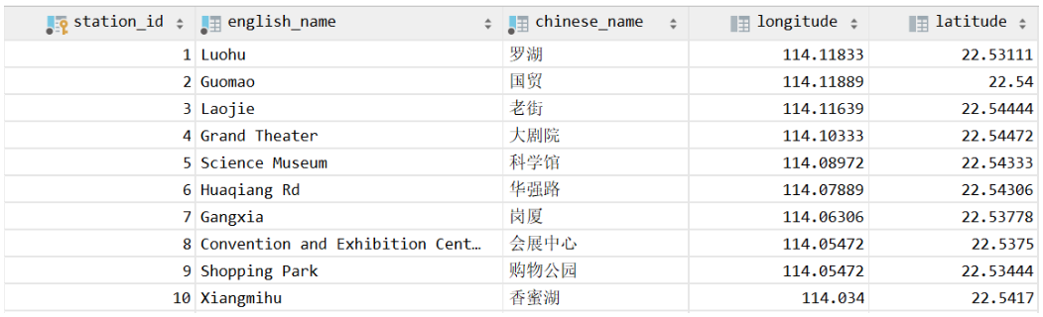
First Normal Form (1NF)
Fix it by splitting the names into two columns

Slide 63
First Normal Form (1NF)
Fix it by treating the column as a multi-valued attribute
Movie ID | Movie Title | Country | Year | Director
0 | Citizen Kane | US | 1941 | welles, o.
1 | La règle du jeu | FR | 1939 | Renoir, J.
2 | North By Northwest | US | 1959 | HITCHCOCK, A.
3 | Singin' in the Rain | US | 1952 | Donen/Kelly
4 | Rear Window | US | 1954 | Alfred Hitchcock
Star ID | Firstname | Lastname | Born | Died
1
2
3
movie_starring

Slide 64
Second Normal Form (2NF)
A relation satisfying 2NF must:
be in 1NF
not have any non-prime attribute that is dependent on any proper subset of any candidate key of the relation
A non-prime attribute of a relation is an attribute that is not a part of any candidate key of the relation.

Slide 65
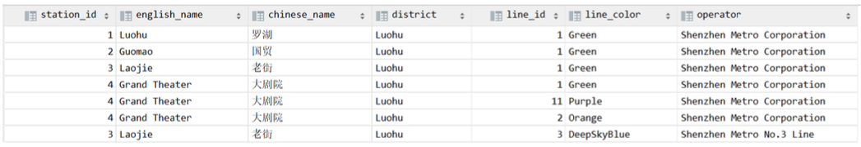
Second Normal Form (2NF)
Example: Consider this table with the composite primary key (station_id, line_id)
The columns line_color and operator are not related to station_id
They are only related to line_id, which is only part of (a subset of) the primary key
Similarly, english_name, chinese_name, and district are not related to line_id
They are only related to station_id, which is only part of (a subset of) the primary key

Slide 66
Second Normal Form (2NF)
Example: Consider this table with the composite primary key (station_id, line_id)
Problem when NOT meeting 2NF: Insertion & deletion anomaly
We cannot insert a new station with no lines assigned yet (unless using NULLs)
If we delete a line, all stations associated with this line will be deleted as well

Slide 67
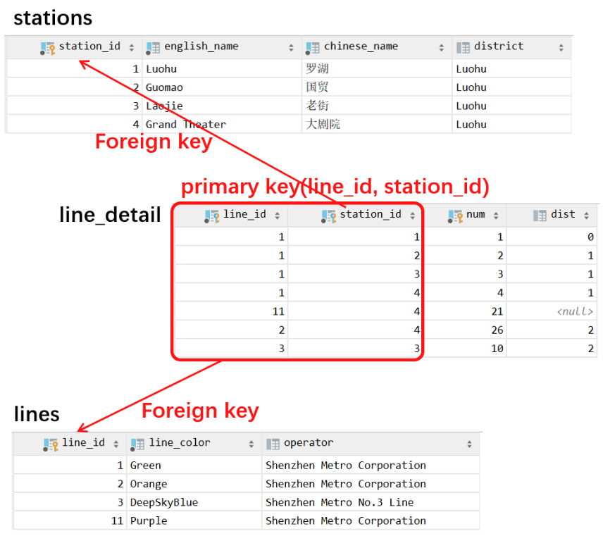
Second Normal Form (2NF)
Fix it by
Splitting the two unrelated parts into two different tables of entities
And create a relationship set (if it is the many-to-many relationship between the two entities)
By the way…
A relation with a single-attribute primary key is automatically in 2NF once it meets 1NF.

Slide 68
Third Normal Form (3NF)
A relation satisfying 3NF must:
be in 2NF
all the attributes in a table are determined only by the candidate keys of that relation and not by any non-prime attributes

Slide 69
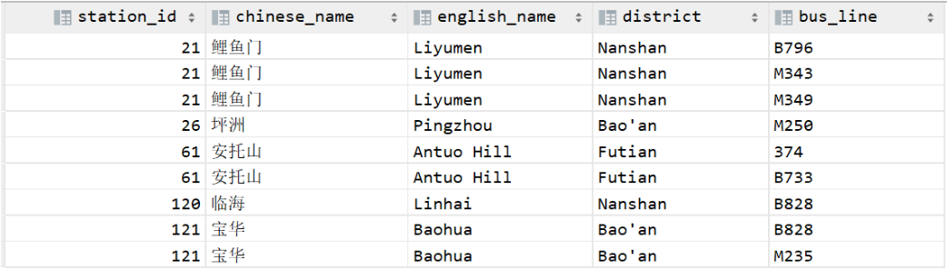
Third Normal Form (3NF)
Example: Consider this table which describes the bus lines and their stops
Primary key (bus_line)
The column station_id depends on the primary key (bus_line)
However, the columns chinese_name, english_name, and district depend on station_id, which is not the primary key.
They only have “indirect/transitive” dependence on the primary key
Problem: Data redundancy

Slide 70
Third Normal Form (3NF)
Example: Consider this table which describes the bus lines and their stops
Primary key (bus_line)
Problem when not meeting 3NF:
Data redundancy: as you can see in the table, the attributes for a station have been stored multiple times
Insertion & deletion anomaly: inserting a new bus line with no station becomes impossible without NULLs; deleting a station/bus line may also delete corresponding bus lines/stations.

Slide 71
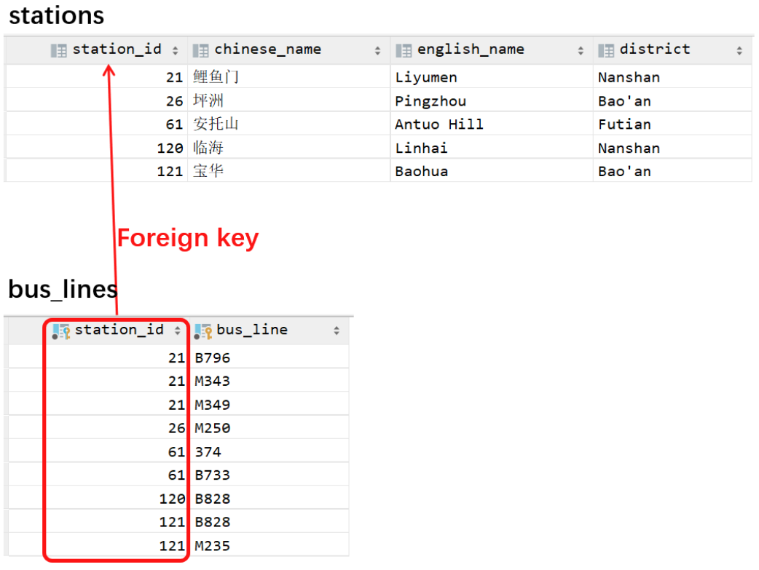
Third Normal Form (3NF)
Fix it by:
Create a new table with station_id as the primary key
i.e., the column which chinese_name, english_name, and district depend on
Move all columns which depend on the new primary key into the new table
And, only leave the primary key of the new table (station_id) in the original table
(*In practice, if necessary) Add a foreign-key constraint
Not related to relational database modeling, only in implementations

Slide 72
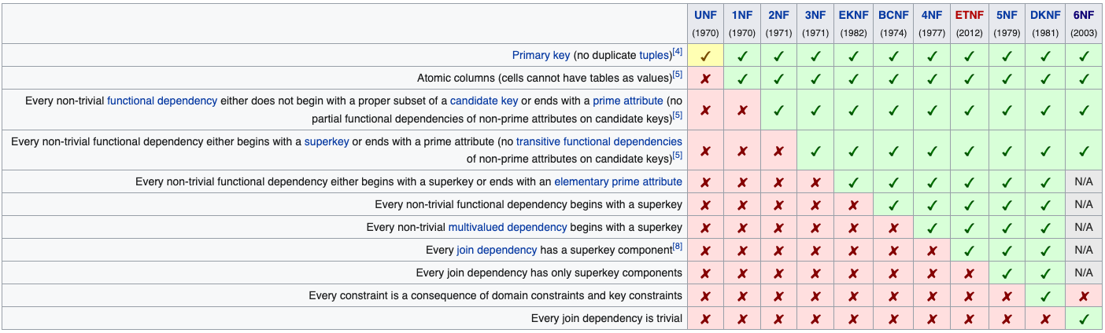
Normalization
In practice, we usually just satisfy 1NF, 2NF and 3NF
https://en.wikipedia.org/wiki/Database_normalization

Slide 73
More to Read
A formal definition of NFs
Chapter 7, Relational Database Design, “Database System Concepts”
The original research papers on normal forms
E. F. Codd. 1970. A relational model of data for large shared data banks. Commun. ACM 13, 6 (June 1970), 377–387. DOI:https://doi.org/10.1145/362384.362685
Codd, E. F.. “Further Normalization of the Data Base Relational Model.” Research Report / RJ / IBM / San Jose, California RJ909 (1971).
Armstrong, William Ward. “Dependency Structures of Data Base Relationships.” IFIP Congress (1974).

